Slide 1


Muhammad Rusydi Al Affan
Agustus 2023

Slide 2

Outline
Executive Summary
Introduction
Methodology
Results
Conclusion
Appendix

Slide 3
Executive Summary
In this project, we harnessed the power of data science to analyze and optimize SpaceX's space launch outcomes. By leveraging various machine learning algorithms, we aimed to identify patterns and factors influencing launch success, ultimately enhancing mission reliability and efficiency.
We gathered extensive datasets on SpaceX's space launch records. We employed multiple machine learning models, including Logistic Regression, and Support Vector Machine, Decision Tree. GridSearchCV was utilized to identify the best hyperparameters for each model, ensuring optimal performance. And Finally, we evaluated the models.
Our data science approach has provided valuable insights into SpaceX's space launch outcomes. The Decision Tree model exhibited the highest accuracy on validation data, indicating its potential as the most robust and reliable method for predicting mission success. Leveraging data science in space exploration will continue to be instrumental in advancing humanity's reach into the cosmos.

Slide 4
Introduction
Over the years, SpaceX has accumulated a vast amount of data on space launches, including various parameters such as booster versions, payload masses, and launch sites. With the increasing frequency of space missions, there is a need to analyze this data and optimize mission outcomes to ensure mission success and reliability.
Problems you want to find answers
Mission Success Prediction: Can we predict the success of space missions based on historical launch data and mission parameters?
Influencing Factors: What are the key factors that influence the success or failure of space launches, such as payload mass or launch site location?
Optimal Model Selection: Which machine learning model offers the most accurate predictions for mission success and can be used for future mission planning?
Enhancing Mission Reliability: How can data science be leveraged to improve mission reliability and identify potential areas for optimization in SpaceX's space launches?

Slide 5

Section 1

Slide 6
Methodology
Executive Summary
Data collection methodology:
We gathered comprehensive space launch data from various sources, including booster versions, payload masses, launch sites, outcomes, and more. We get with API data Retrieval and Web Scraping
Perform data wrangling
To ensure data quality, we cleaned, handled missing values, and standardized the dataset for further analysis.
Perform exploratory data analysis (EDA) using visualization and SQL
Perform interactive visual analytics using Folium and Plotly Dash
Perform predictive analysis using classification models
Utilizing machine learning algorithms such as Logistic Regression, Support Vector Machines (SVM) and Decision Trees. We employed techniques like GridSearchCV to optimize model hyperparameters, enhancing their predictive capabilities. we visualized confusion matrices.

Slide 7
Data Collection
Data From Space X was obtain from 2 source:
SpaceX API (https://api.spacexdata.com/v4/launches/past )
WebScraping from Wikipedia (https://en.wikipedia.org/wiki/List_of_Falcon_9_and_Falcon_Heavy_launches )
During the data collection process, we obtained several lists of features such as 'rocket', 'payloads', 'launchpad', 'cores', 'flight_number', and 'date_utc'. However, it is important to note that the data in these lists only consists of IDs. These IDs serve as parameters that need to be used to retrieve additional information from the provided API.

Slide 8
Data Collection – SpaceX API
SpaceX offers a public API from where data can be obtained and then used
The GitHub URL of the completed SpaceX API calls notebook : https://github.com/rusydi16/Final-Assignment/blob/main/Course%2010/jupyter-labs-spacex-data-collection-api.ipynb
Get Request to API to get Past Data
Using IDs as parameters, we can make API calls to retrieve relevant information
Data Wrangling

Slide 9
Data Collection - Scraping
Data SpaceX can also be obtained from Wikipedia via WebScraping
The GitHub URL of the completed web scraping notebook : https://github.com/rusydi16/Final-Assignment/blob/main/Course%2010/jupyter-labs-webscraping.ipynb
Get Request to API to get Past Data
Identify the HTML elements containing the data you want to scrape.
Extract and Store Data

Slide 10
Data Wrangling
The collected data underwent extensive cleaning to handle missing values, remove duplicates, and correct inconsistent data formats.
We also perform EDA (Exploratory Data Analysis) to more understand the Information contains inside the data
GitHub URL of your completed data wrangling related notebooks : https://github.com/rusydi16/Final-Assignment/blob/main/Course%2010/labs-jupyter-spacex-data_wrangling_jupyterlite.jupyterlite.ipynb
Data Cleaning
EDA
(Exploratory Data Analysis)
Determine Training Set
(Features and Label)

Slide 11
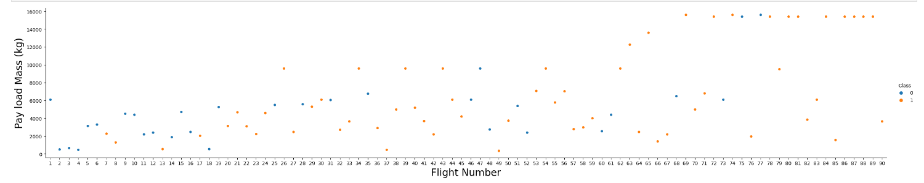
EDA with Data Visualization
To explore data, scatterplots and bar plots were used to visualize the relationship between pair of
For example : This chart show relationship between flight number and payload Mass with Class Success Status of The Operation
Add the GitHub URL of your completed EDA with data visualization notebook: https://github.com/rusydi16/Final-Assignment/blob/main/Course%2010/jupyter-labs-eda-dataviz.ipynb.jupyterlite%20(1).ipynb

Slide 12
EDA with SQL
Summarize the SQL queries:
Display the names of the unique launch sites in the space mission
Display 5 records where launch sites begin with the string 'CCA’
Display the total payload mass carried by boosters launched by NASA (CRS)
Display average payload mass carried by booster version F9 v1.1
List the date when the first successful landing outcome in ground pad was acheived.
List the names of the boosters which have success in drone ship and have payload mass greater than 4000 but less than 6000
List the total number of successful and failure mission outcomes
List the names of the booster_versions which have carried the maximum payload mass. Use a subquery
List the records which will display the month names, failure landing_outcomes in drone ship ,booster versions, launch_site for the months in year 2015.
Rank the count of landing outcomes (such as Failure (drone ship) or Success (ground pad)) between the date 2010-06-04 and 2017-03-20, in descending order.
GitHub URL of your completed EDA with SQL notebook : https://github.com/rusydi16/Final-Assignment/blob/main/Course%2010/jupyter-labs-eda-sql-coursera_sqllite.ipynb

Slide 13
Build an Interactive Map with Folium
Summarize what map objects :
Markers indicate points like launch sites;
Circles indicate highlighted areas around specific coordinates, like NASA Johnson Space Center;
Marker clusters indicates groups of events in each coordinate, like launches in a launch site; and
Lines are used to indicate distances between two coordinates.
To demonstrate the distance between critical objects and the radius of the launch site, providing an overview of safety and accessibility.
GitHub URL of your completed interactive map with Folium map: https://github.com/rusydi16/Final-Assignment/blob/main/Course%2010/lab_jupyter_launch_site_location.jupyterlite.ipynb

Slide 14
Build a Dashboard with Plotly Dash
Summarize what plots/graphs and interactions that added to a dashboard :
A Pie Chat that showing the total launches by a certain sites (Sites Can be Selected by a Dropdown Menu)
scatter graph showing the relationship with Outcome and Payload Mass (Kg) for the different booster version. Payload Mass can be selected by range plot.
Explain why you added those plots and interactions
GitHub URL of your completed Plotly Dash lab : https://github.com/rusydi16/Final-Assignment/blob/main/Course%2010/spacex_dash_app.py

Slide 15
Predictive Analysis (Classification)
loaded the data using numpy and pandas, transformed the data, split our data into training and testing, then built different machine learning models and tune different hyperparameters using GridSearchCV. And we used accuracy as the metric for our model, improved the model using feature engineering and algorithm tuning. Finally, We found the best performing classification model.
Add the GitHub URL of your completed predictive analysis lab: https://github.com/rusydi16/Final-Assignment/blob/main/Course%2010/SpaceX_Machine_Learning_Prediction_Part_5.jupyterlite.ipynb
Data Pre-Processing
Learning Model
Tune and Hyperparameter Models
Evaluate the Models

Slide 16
Results
Exploratory data analysis results
Space X uses 4 different launch sites;
The first launches were done to Space X itself and NASA;
The average payload of F9 v1.1 booster is 2,928 kg;
The first success landing outcome happened in 2015 fiver year after the first launch;
Many Falcon 9 booster versions were successful at landing in drone ships having payload above the average;
Almost 100% of mission outcomes were successful;
Two booster versions failed at landing in drone ships in 2015: F9 v1.1 B1012 and F9 v1.1 B1015;
The number of landing outcomes became as better as years passed.

Slide 17
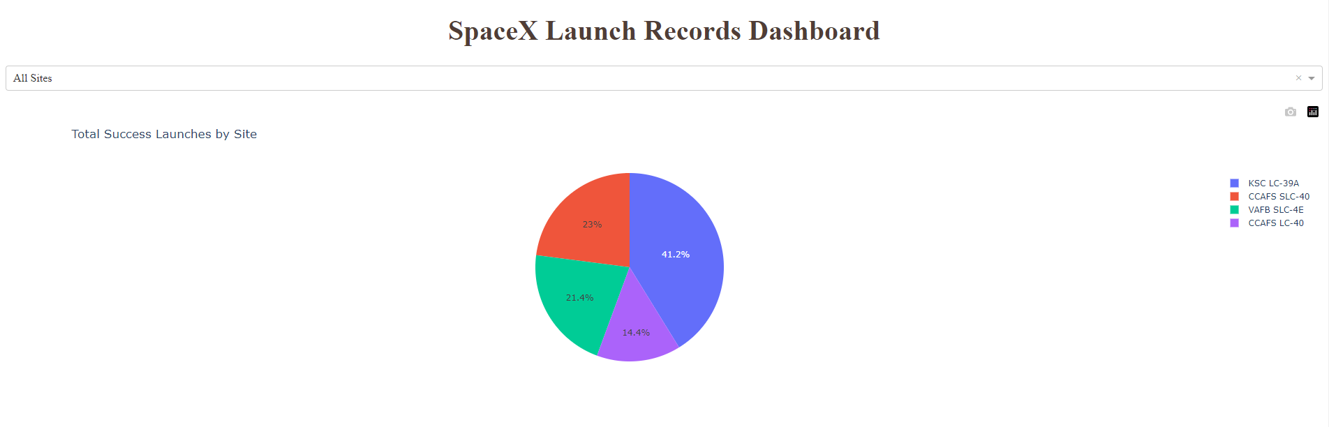
Results
Interactive analytics demo in screenshots :

Slide 18
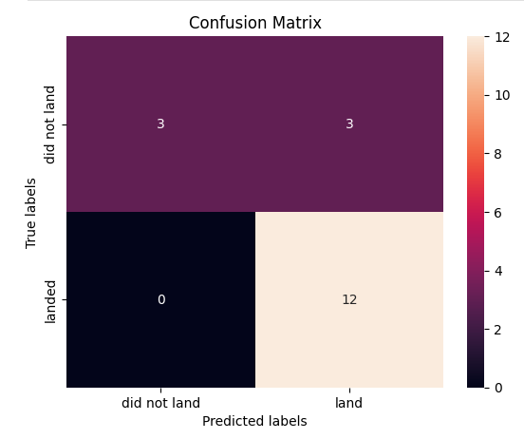
Results
Predictive analysis results
With The best Model Method is Decision Tree
Accuracy on Validation Data : ~88%

Slide 19

Section 2

Slide 20
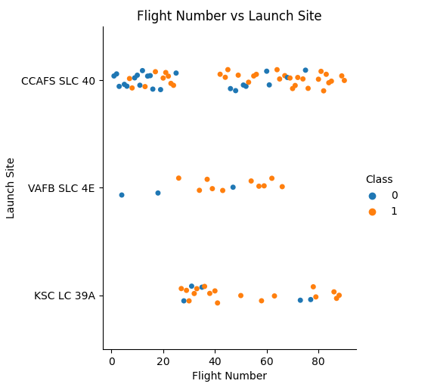

Flight Number vs. Launch Site
we found that the larger the flight amount at a launch site, the greater the success rate at a launch site.

Slide 21
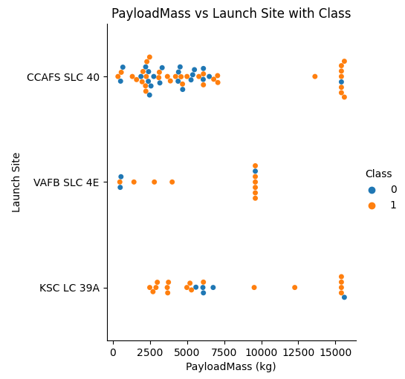
Payload vs. Launch Site
The Greater the payload mass for launce Site CCAFS SLC 40 the higher the success rate for the rocket

Slide 22
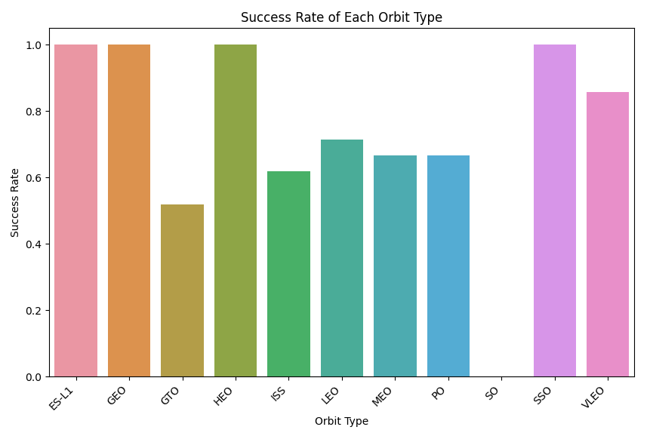
Success Rate vs. Orbit Type
From the plot, we can see ES-L1, GEO, HEO, SSO had the most success rate and SO had the less success rate

Slide 23
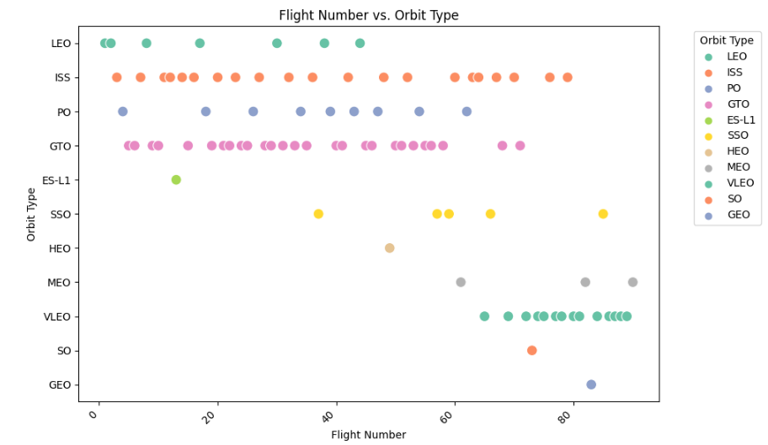
Flight Number vs. Orbit Type
We observe that in the LEO orbit, success is related to the number of flights whereas in the GTO orbit, there is no relationship between flight number and the orbit

Slide 24
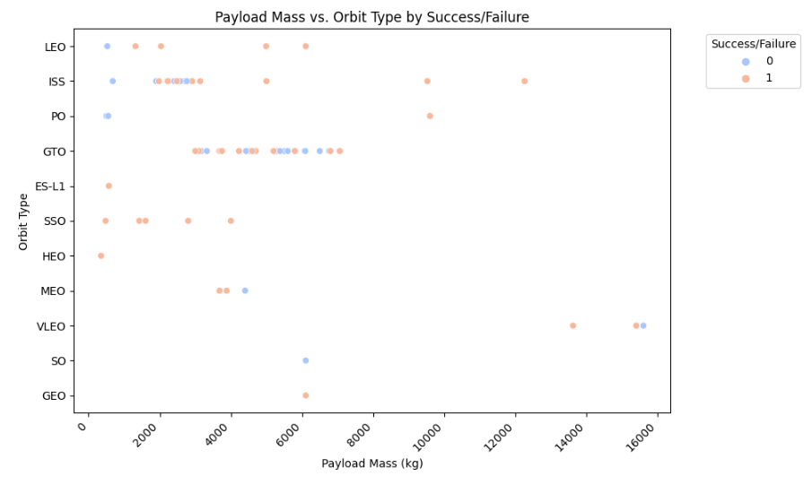
Payload vs. Orbit Type
We can observe that with heavy payloads, the successful landing are more for VLEO, LEO and ISS orbits

Slide 25
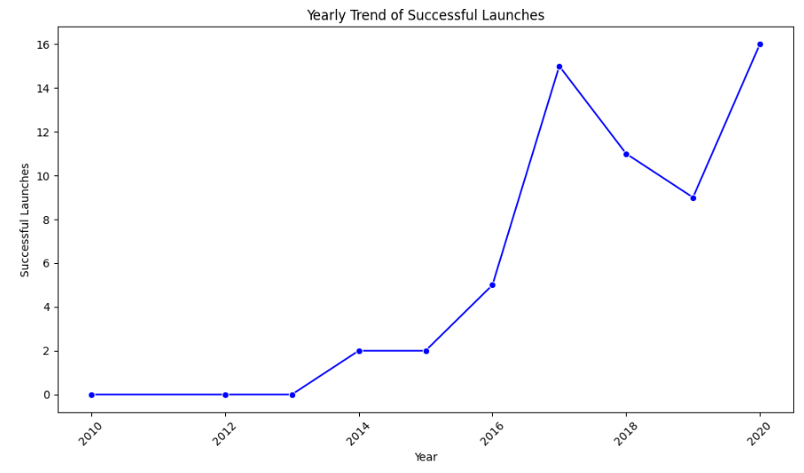
Launch Success Yearly Trend
From the plot, we can observe that success rate since 2013 kept on increasing till 2020.

Slide 26
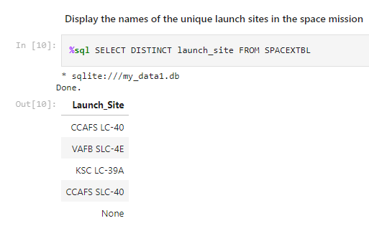
All Launch Site Names
We used the key word DISTINCT to show only unique launch sites from the SpaceX data.

Slide 27
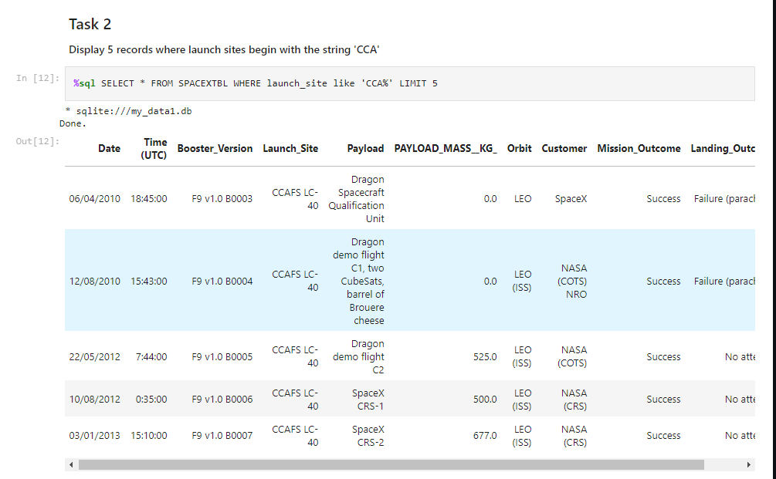
Launch Site Names Begin with 'CCA'
We used LIKE and Wildcard symbol for query the pattern of CCA launch Sites

Slide 28
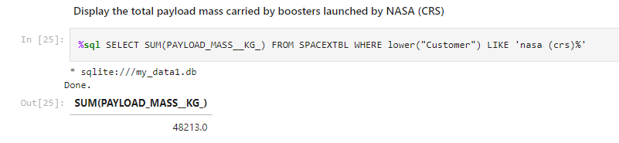
Total Payload Mass
We calculated the total payload carried by boosters from NASA as 45596 using SUM() Function

Slide 29
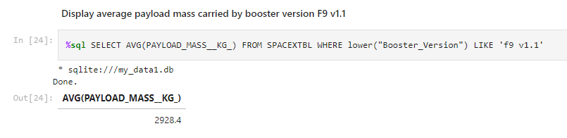
Average Payload Mass by F9 v1.1
We calculated the average payload mass carried by booster version F9 v1.1 as 2928.4

Slide 30
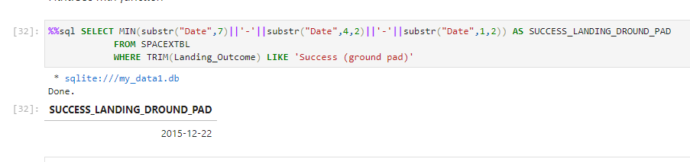
First Successful Ground Landing Date
We observed that the dates of the first successful landing outcome on ground pad was 22nd December 2015. We used Substr() to ekstract DAY, MONTH, YEAR FROM Date Column because the data type from column is not perform well using MIN() Function.

Slide 31
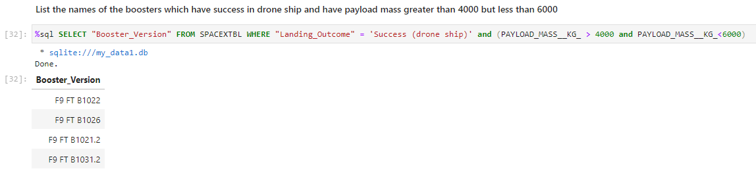
Successful Drone Ship Landing with Payload between 4000 and 6000
We used the WHERE clause to filter for boosters which have successfully landed on drone ship and applied the AND condition to determine successful landing with payload mass greater than 4000 but less than 6000

Slide 32
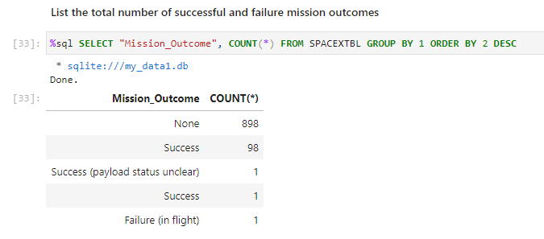
Total Number of Successful and Failure Mission Outcomes
We User Count() Function and GROUP BY to know each Mission Outcomes Flight Number

Slide 33
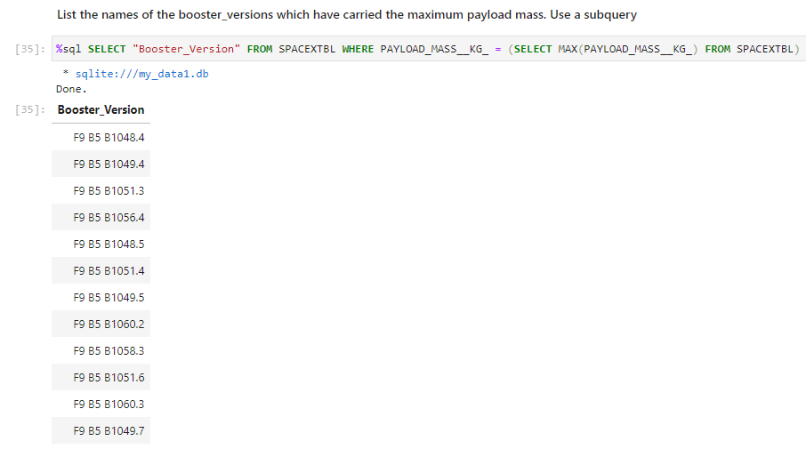
Boosters Carried Maximum Payload
We determined the booster that have carried the maximum payload using a subquery in the WHERE clause and the MAX() function

Slide 34
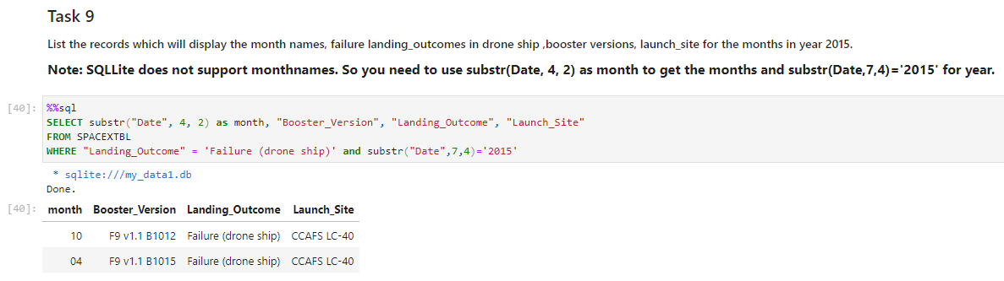
2015 Launch Records
We used SUBSTRING to extract Months from Date Column and WHERE Clause to filter the output.

Slide 35
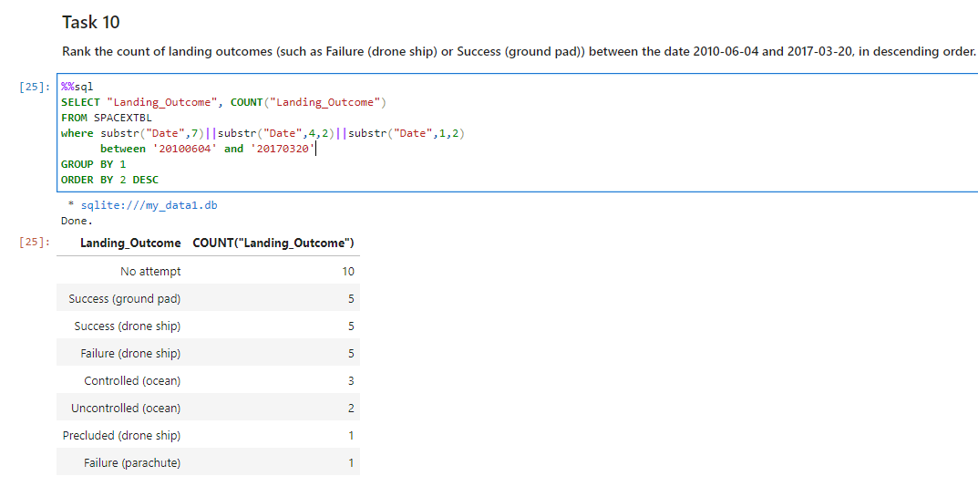
Rank Landing Outcomes Between 2010-06-04 and 2017-03-20
We selected Landing outcomes and the COUNT of landing outcomes from the data and used the WHERE clause to filter for landing outcomes BETWEEN 2010-06-04 to 2010-03-20.
We applied the GROUP BY clause to group the landing outcomes and the ORDER BY clause to order the grouped landing outcome in descending order.

Slide 36

Section 3

Slide 37
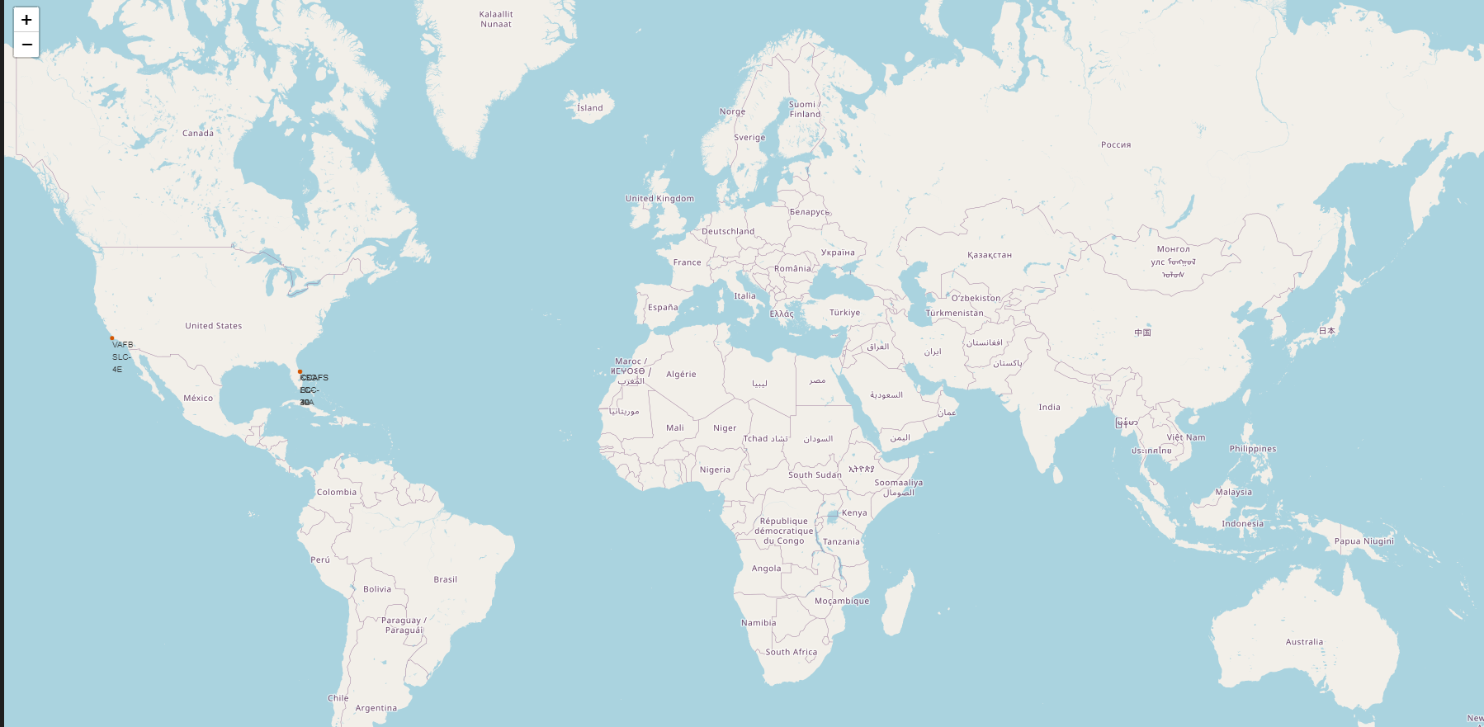
All launch sites global map markers
We Can see That the SpaceX Launch Sites are in United States of America Coasts. Florida and California

Slide 38
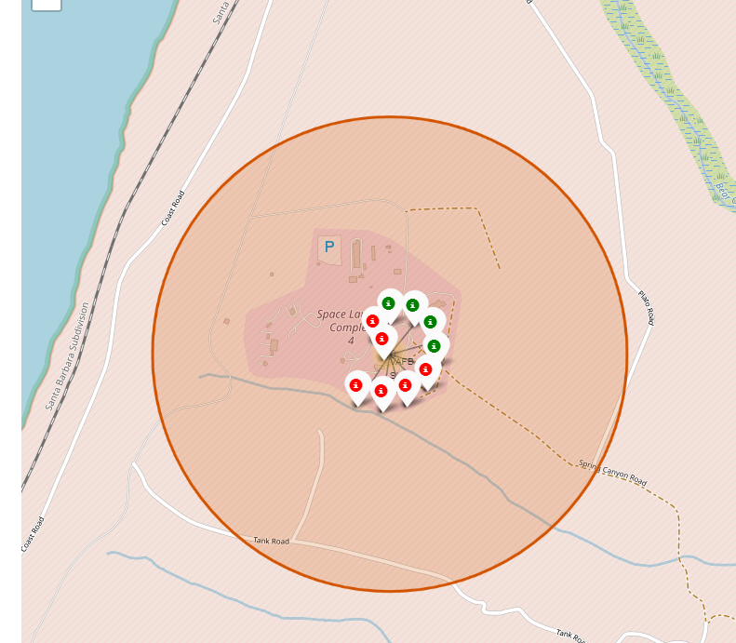
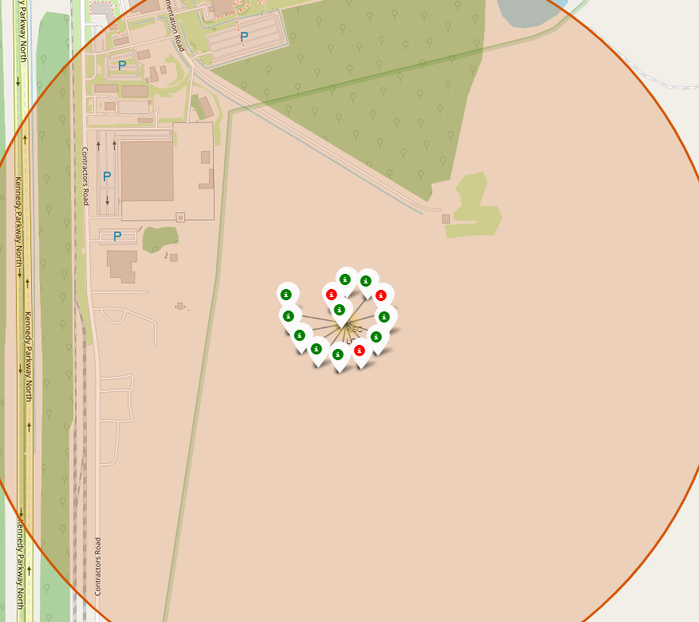
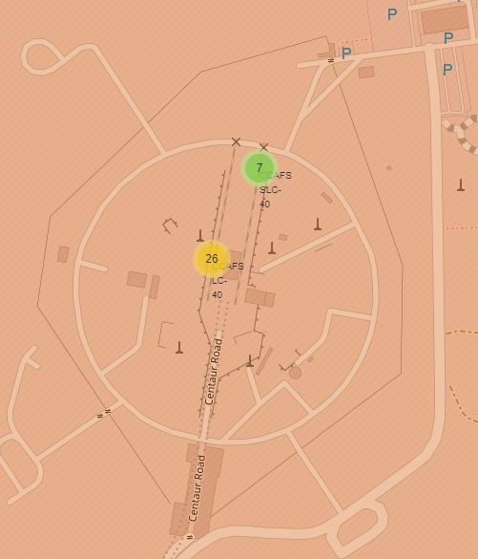
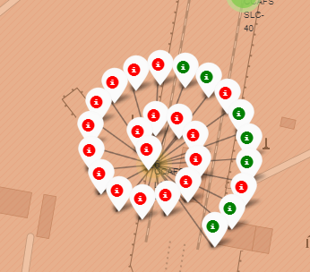
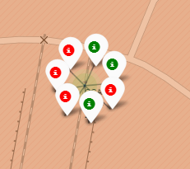
Markers showing launch sites with color labels
California Launch Sites
Florida Launch Sites
Green Marker shows successful Launches and Red Marker Show Failures

Slide 39
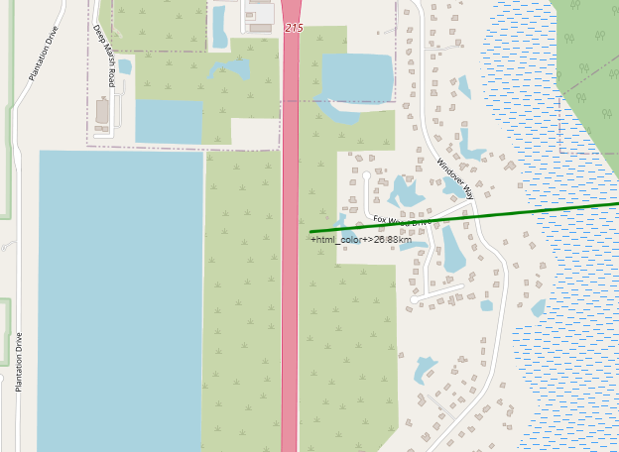
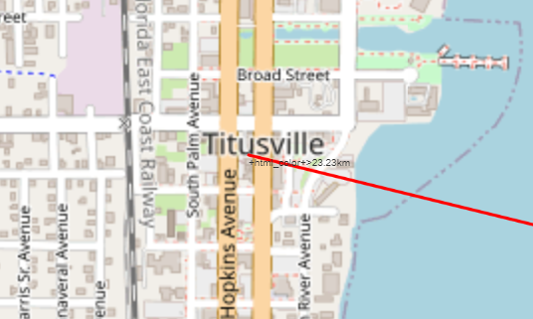
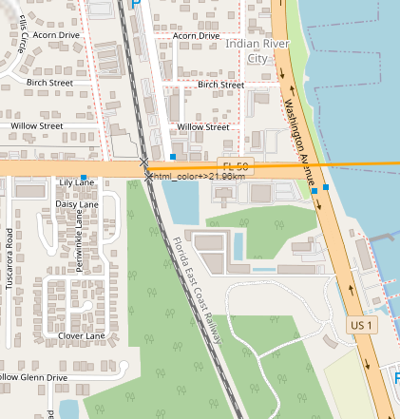
Launch Site distance to landmarks
Are launch sites in close proximity to railways? No
Are launch sites in close proximity to highways? No
Are launch sites in close proximity to coastline? Yes
Do launch sites keep certain distance away from cities? Yes
City Distance 23.234752126023245
Railway Distance 21.961465676043673
Highway Distance 26.88038569681492
Coastline Distance 0.8627671182499878

Slide 40

Section 4

Slide 41

Pie chart showing the success percentage achieved by each launch site
We Can see that KSC LC-39A had the most successful launches from all the sites

Slide 42
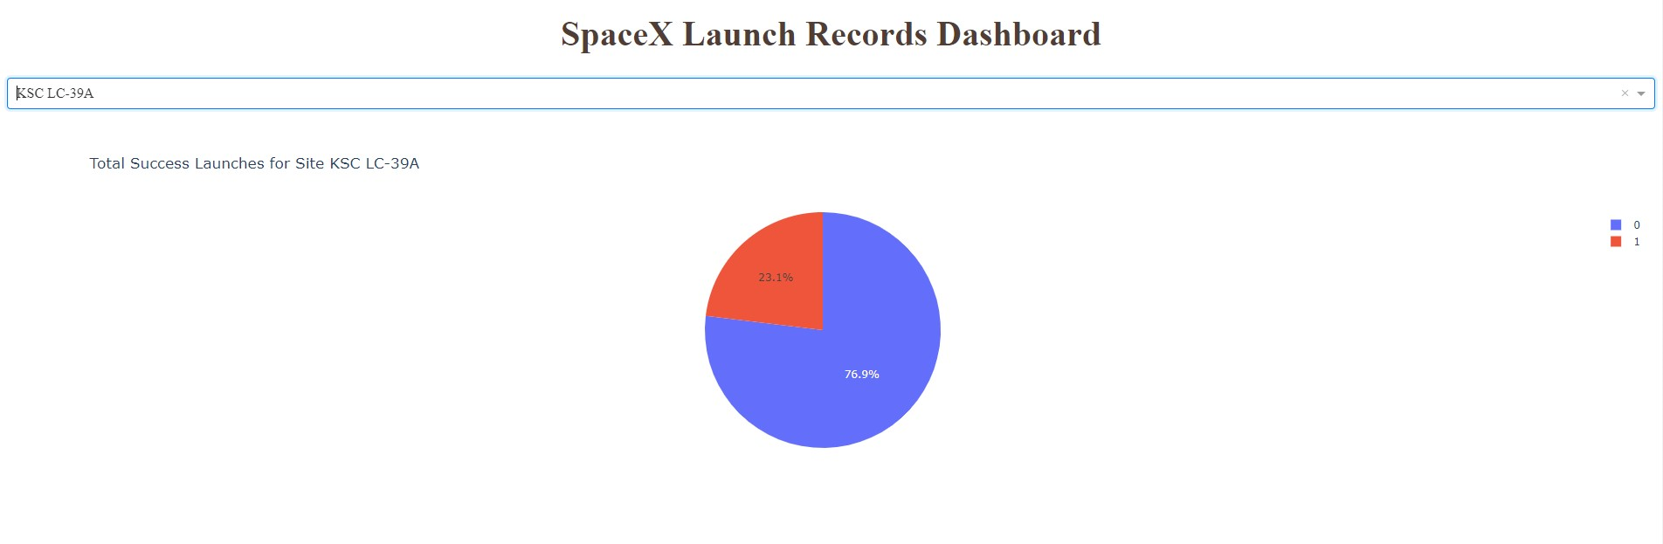
Pie chart showing the Launch site with the highest launch success ratio
KSC LC-39A achieved a 76.9% success rate while getting a 23.1% failure rate

Slide 43
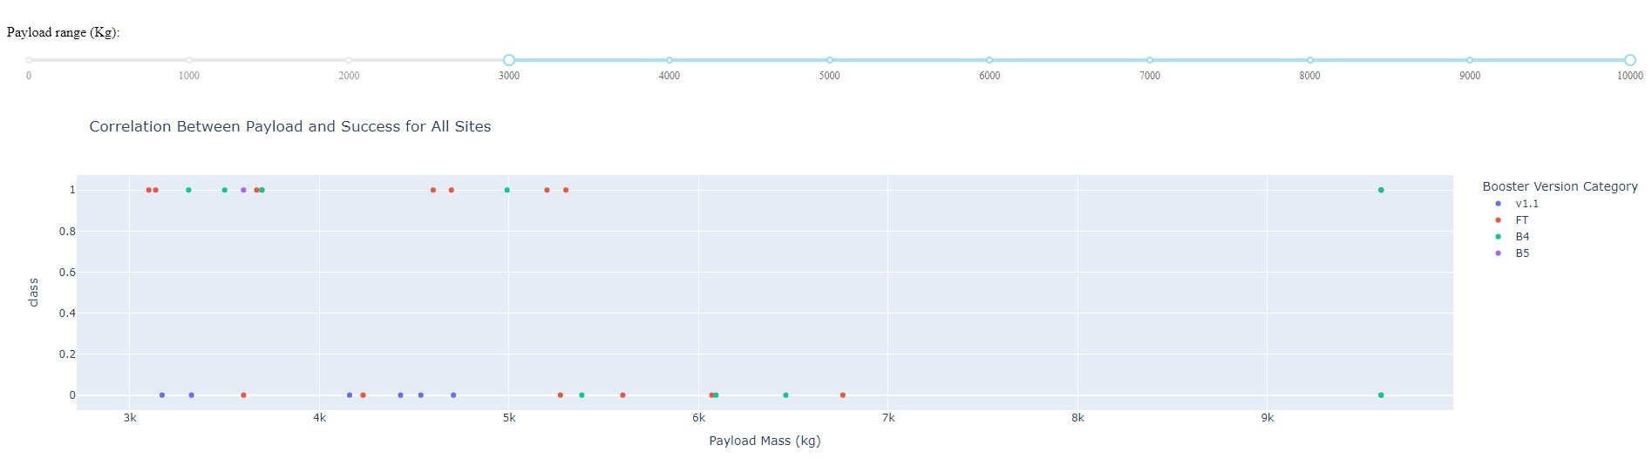
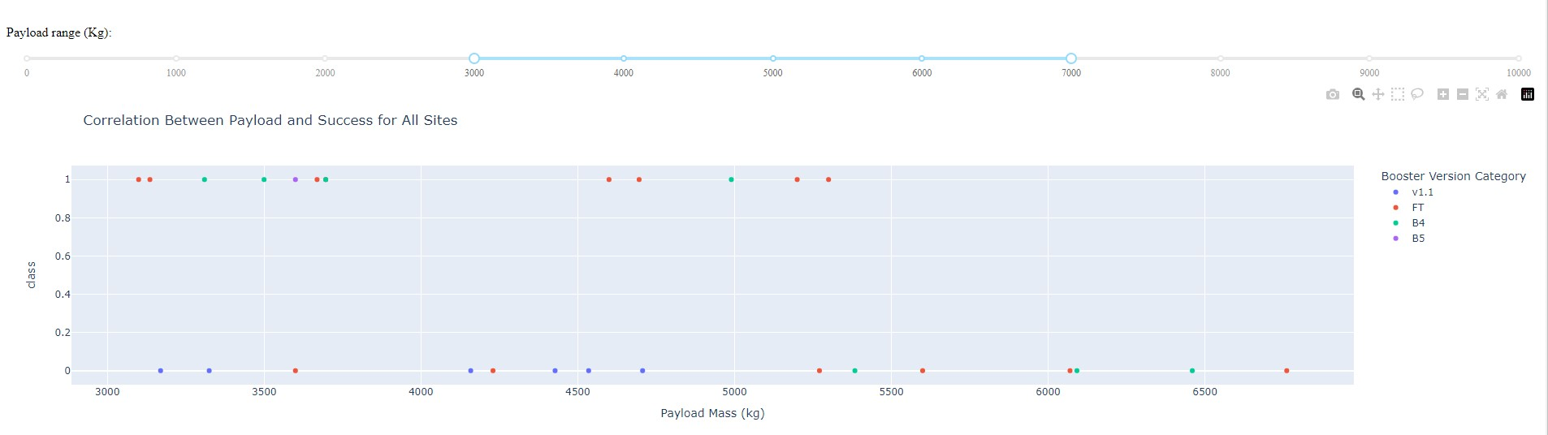
Scatter plot of Payload vs Launch Outcome for all sites, with different payload selected in the range
slider
We can see that success rate low weighted payload is higher than the heavy payloads

Slide 44

Section 5

Slide 45
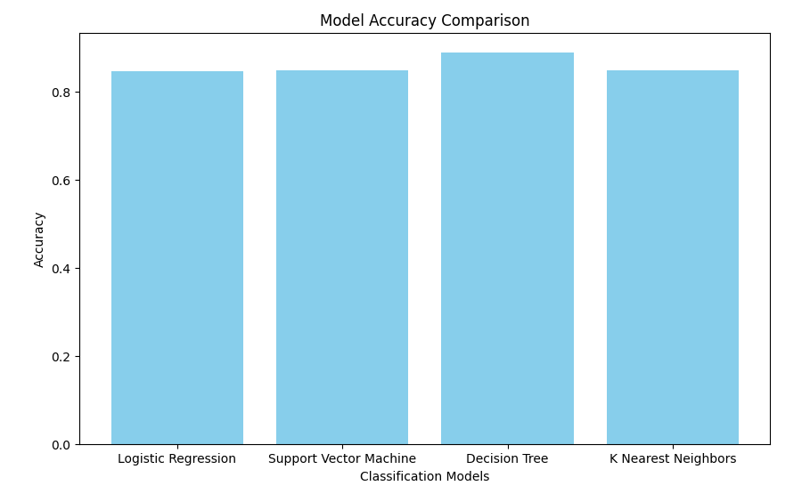
Classification Accuracy
Best performing method: Decision Tree
Accuracy on validation data: 0.8892857142857142
0.8892

Slide 46
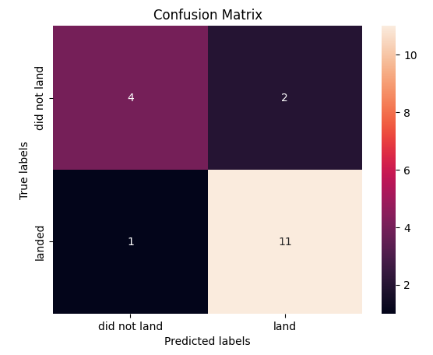
Confusion Matrix
The confusion matrix for the decision tree classifier shows that the classifier can distinguish between the different classes.
The major problem is the false positives .i.e., unsuccessful landing marked as successful landing by the classifier.

Slide 47
Conclusions
We can conclude that:
The larger the flight amount at a launch site, the greater the success rate at a launch site.
Launch success rate started to increase in 2013 till 2020.
Orbits ES-L1, GEO, HEO, SSO, VLEO had the most success rate.
KSC LC-39A had the most successful launches of any sites.
The Decision tree classifier is the best machine learning algorithm for this task.

Slide 48
Appendix
Github Repositori :
https://github.com/rusydi16/Final-Assignment/tree/main/Course%2010

Slide 49


